Slide 1
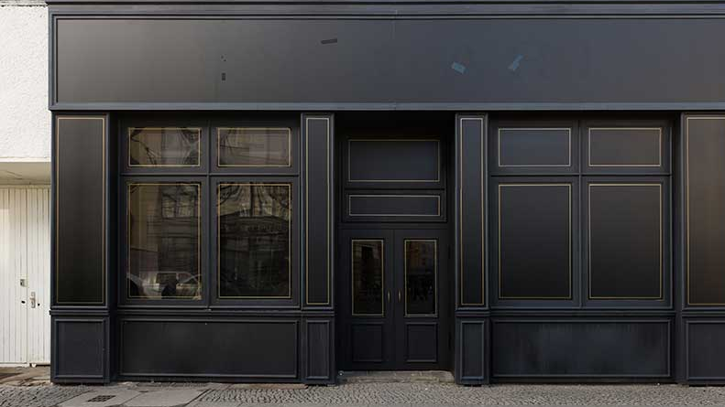
TRADITIONAL BUSINESS - Physical store
1-to-1 marketing
Match products & services to people
Match people to products & services
Product of the products
Trust is built upon professionalism & knowledge

Slide 2
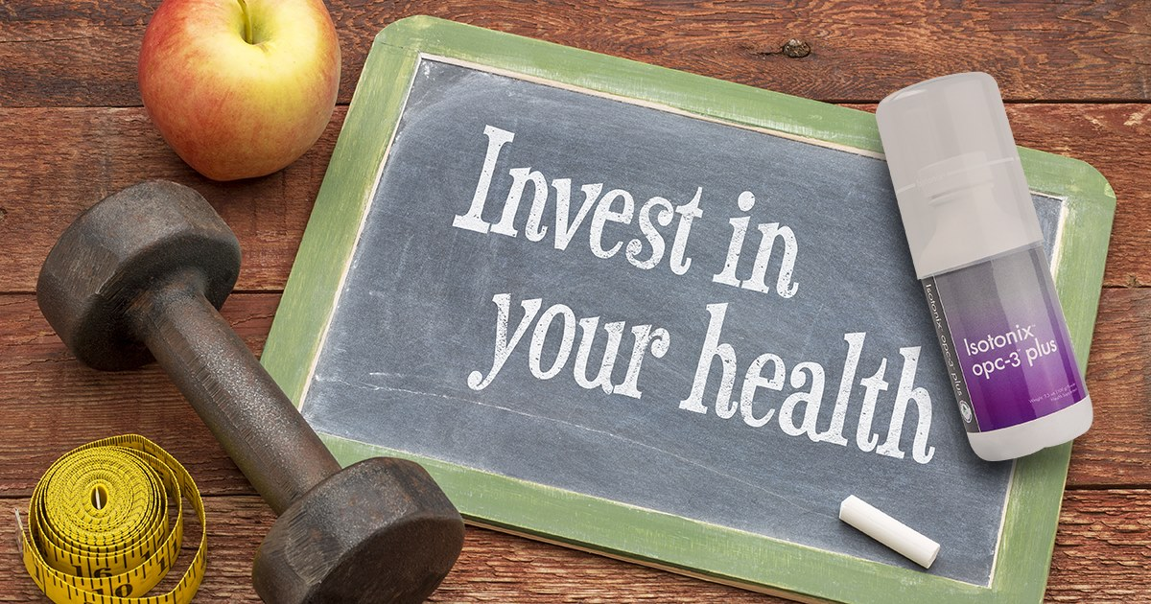
KNOWLEDGE IS WEALTH & HEALTH
PRODUCT KNOWLEDGE
Beauty comes from inside out.
Right supplements are important.
ISOTONIX formula
No discomfort and indigestion

Slide 3
HOME EVENTS – creating awareness
WELLNESS | MOTIVES | HBP
Product demonstration
Product testimonials
IMPACTFUL!!

Slide 4
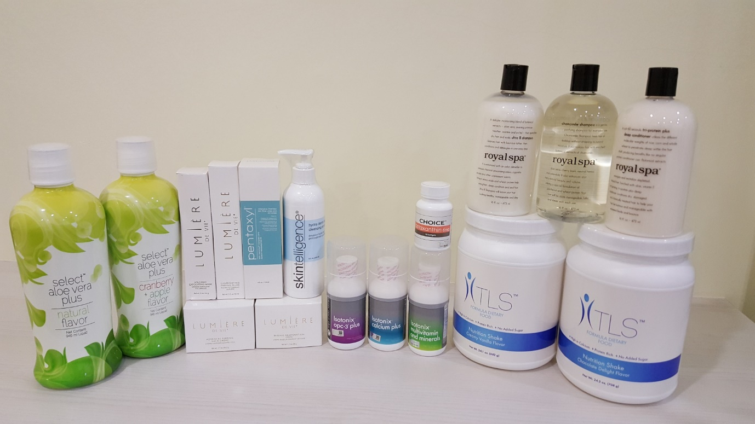
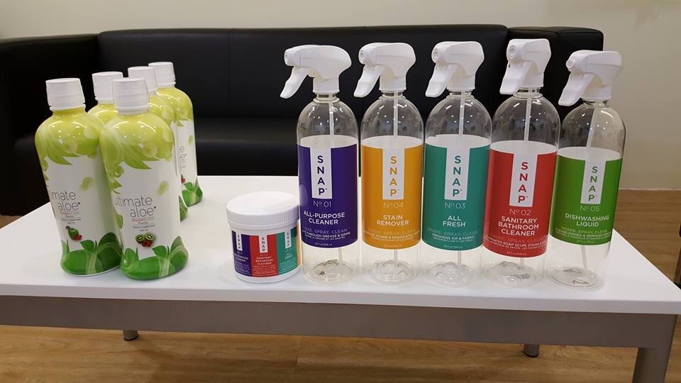
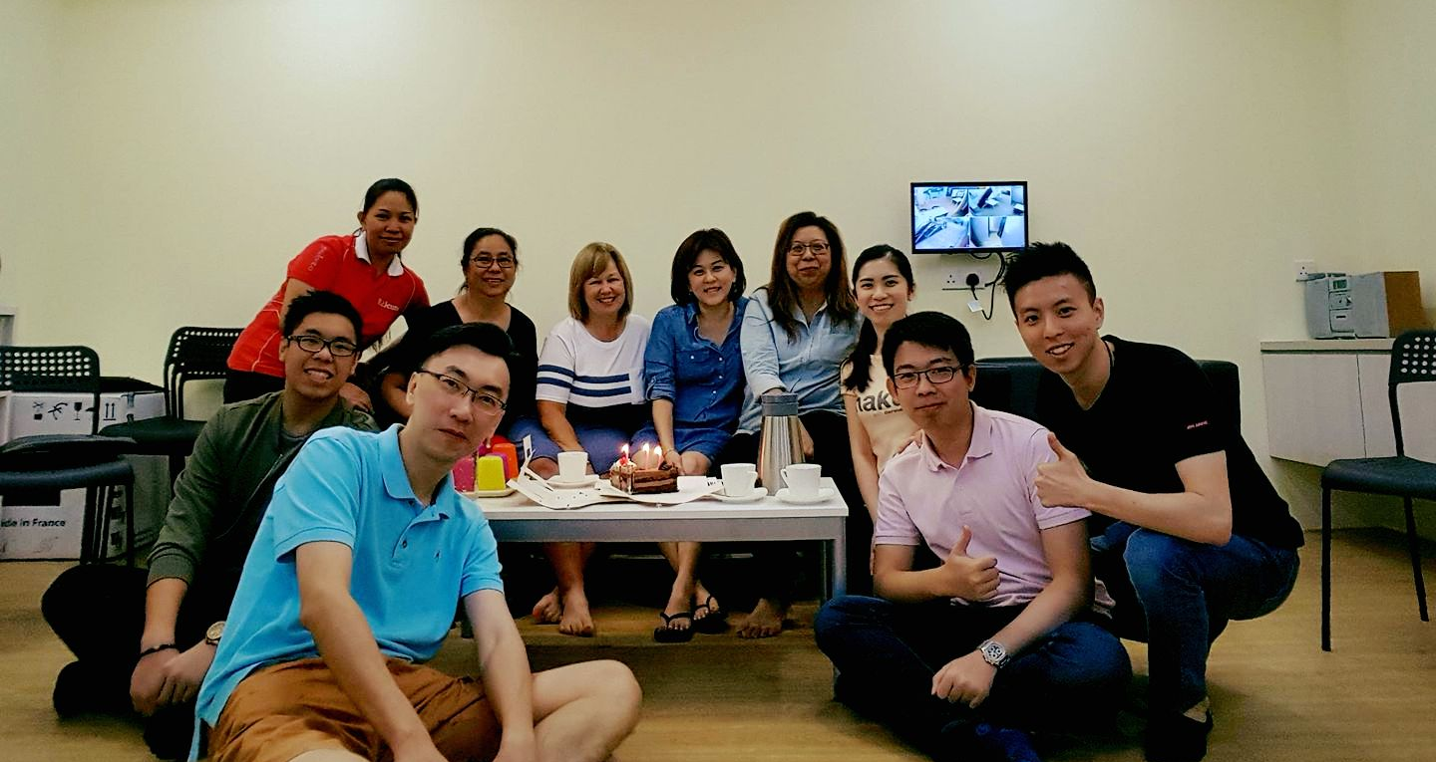
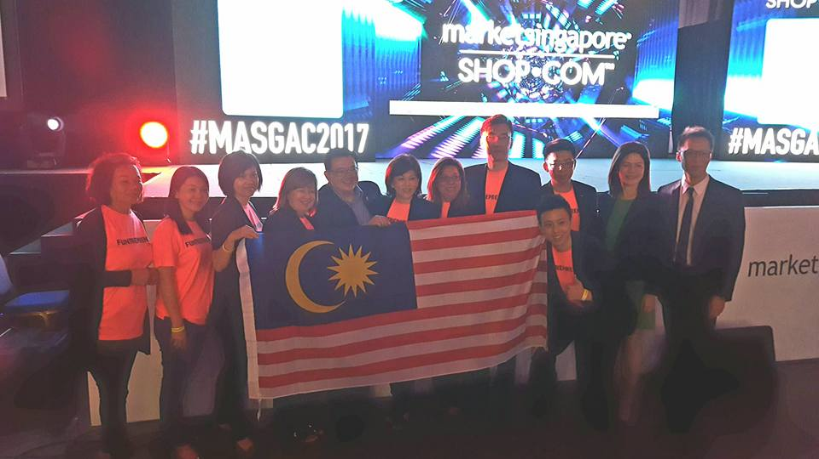

Slide 5
WHAT HOW

Slide 6
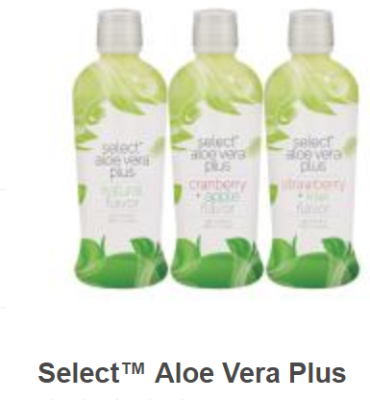
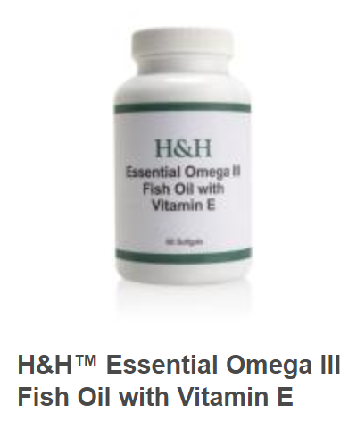
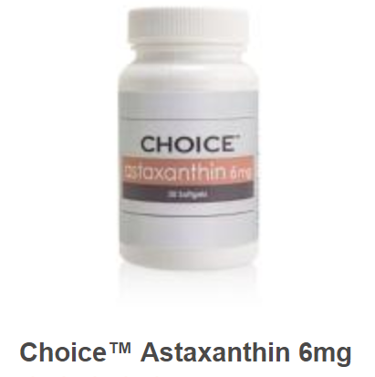
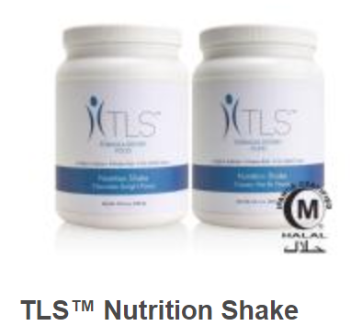
CHALLENGE MYSELF
Retail AT LEAST 1(ONE) Market Malaysia product
Choose the product which I LIKE BEST / I KNOW BEST
SINCERE sharing, feel and see the change in me

Slide 7
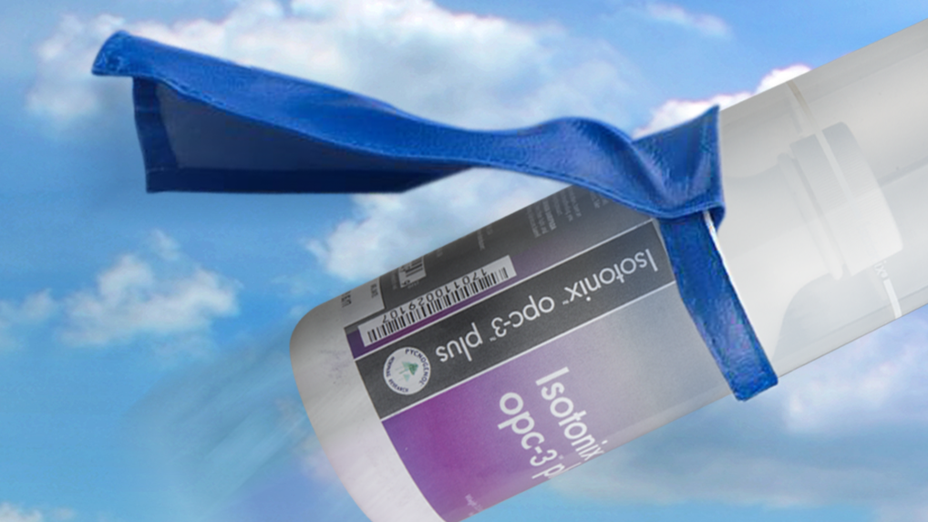
PROCESS | PROGRESS
Self-confidence
Belief & Passion
ME
Product Knowledge
Experience
Posture

Slide 8
DEVELOP A CUSTOMER BASE

Slide 9
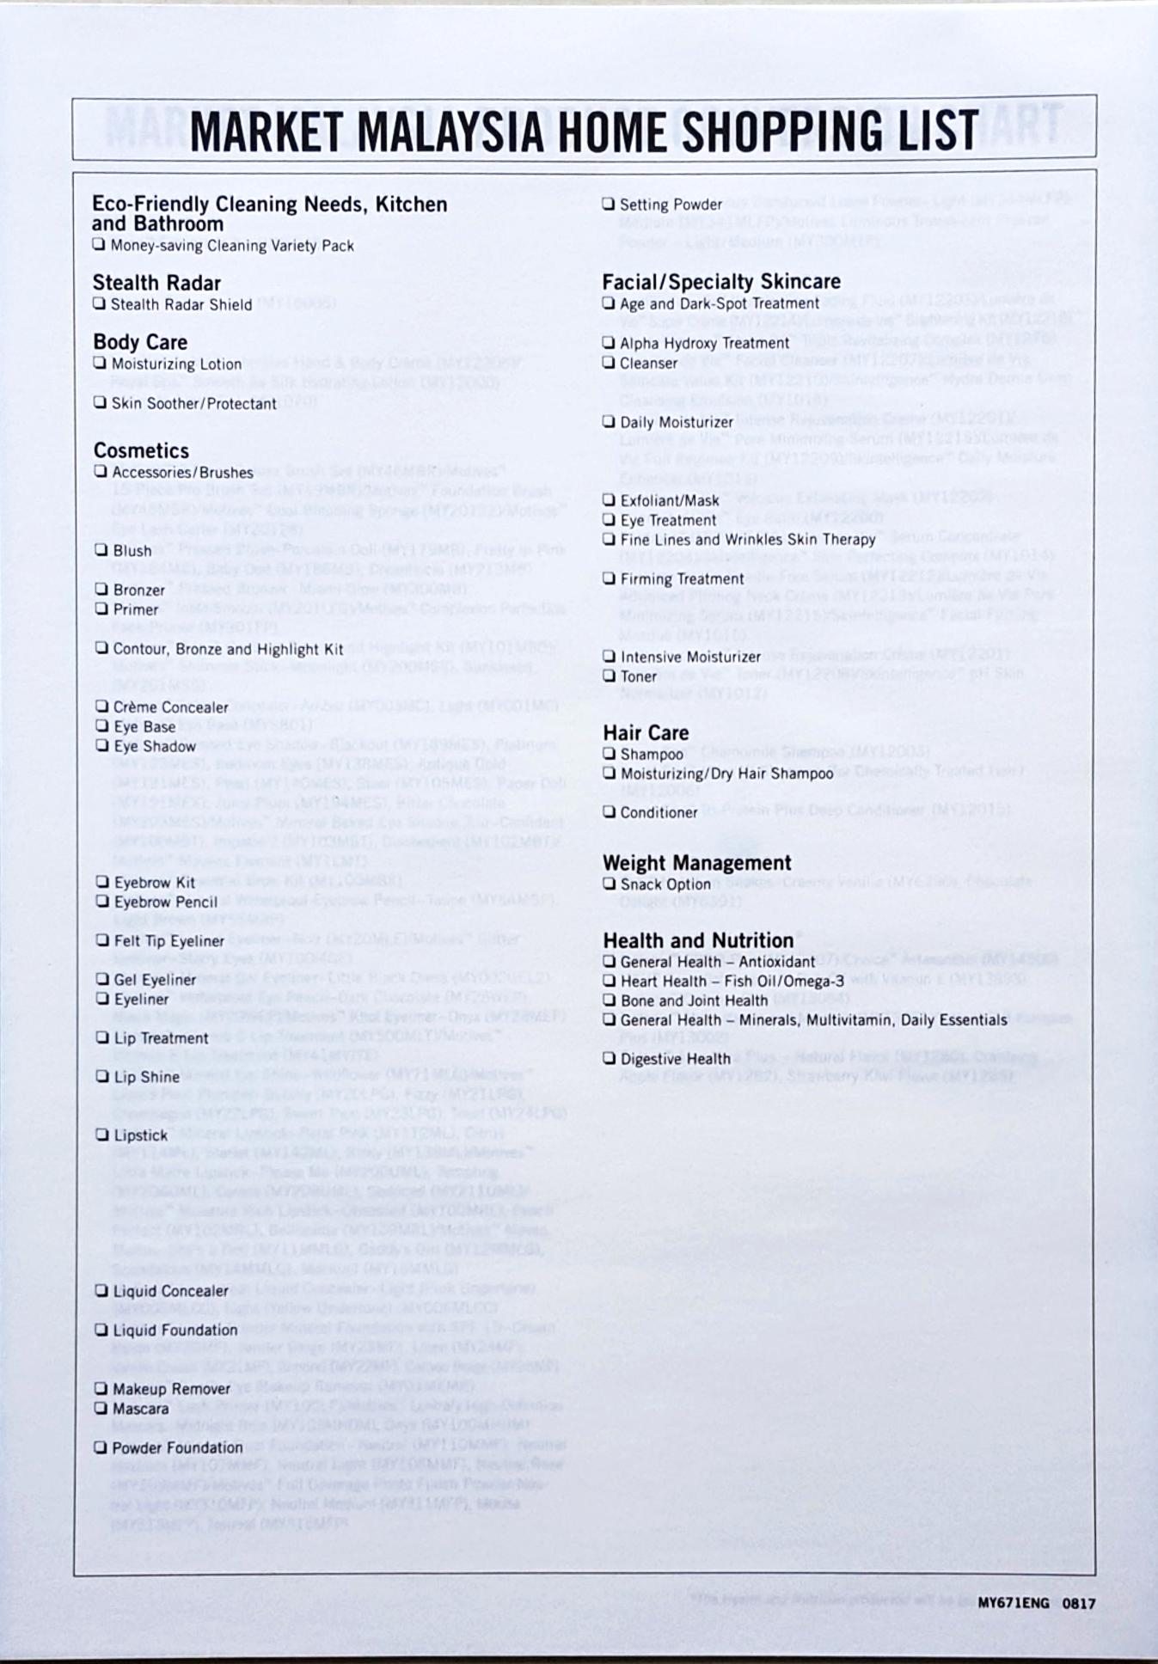
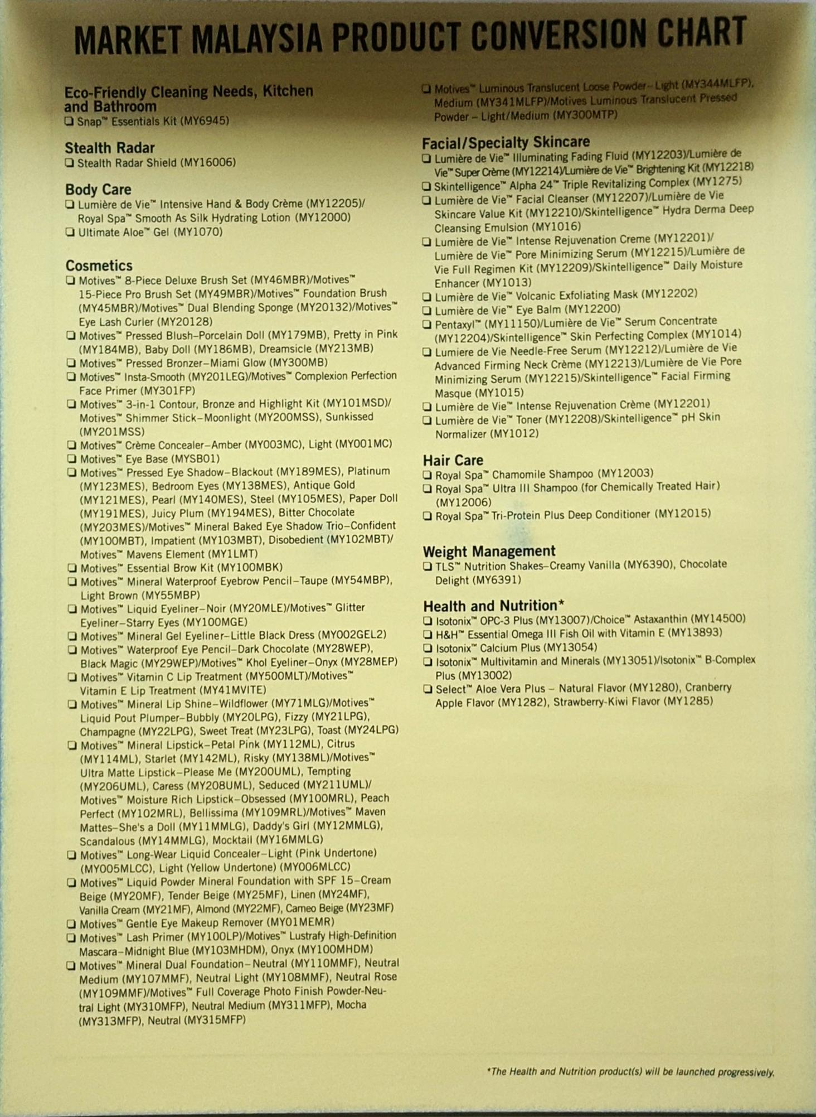
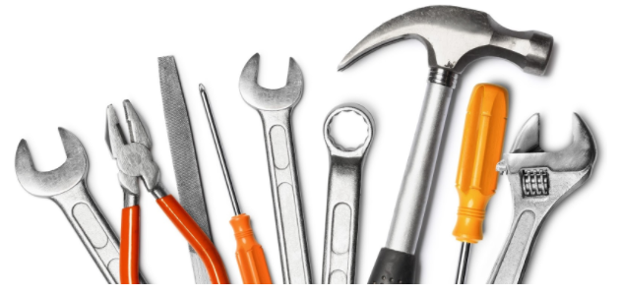
KNOW YOUR TOOLS

